Slide 1
Area of Polygon
Grade 8 – Chapter 15

Slide 2
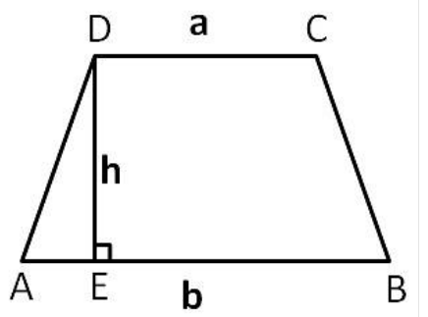
Area of Trapezium
A trapezium, also known as a trapezoid, is a quadrilateral in which a pair of sides are parallel, but the other pair of opposite sides are non-parallel. The area of a trapezium is computed with the following formula:

Slide 3
Example 1

Slide 5
Example 2

